Slide 1

A Good Soldier Or Random Exposure? Chance Opportunities & Frequent Citizenship
Christopher R. Dishop

Slide 2
Inspiration

Slide 3
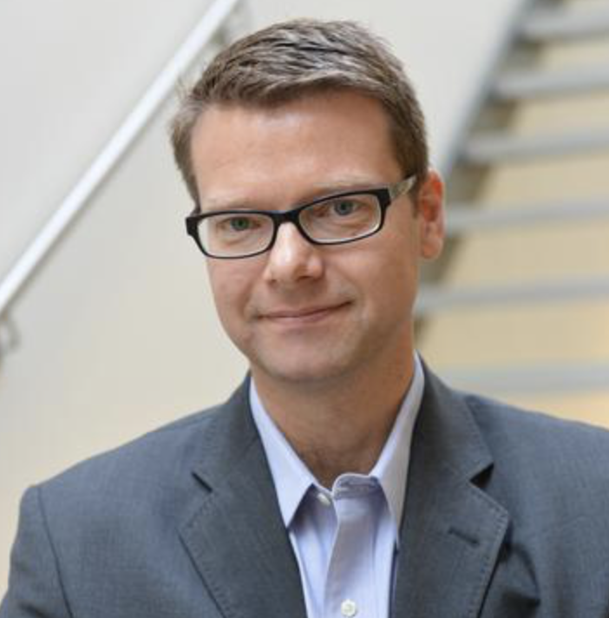
Inspiration

Slide 4
Inspiration
Random

Slide 5
Inspiration
Random
…variation should be considered one of the most important explanatory mechanisms in the management sciences

Slide 6
Inspiration
Random
…variation should be considered one of the most important explanatory mechanisms in the management sciences
…events impact organizational behavior

Slide 7
Inspiration
Random
…variation should be considered one of the most important explanatory mechanisms in the management sciences
…events impact organizational behavior
…models provide parsimonious explanations of empirical regularities

Slide 8
Inspiration
Random
…variation should be considered one of the most important explanatory mechanisms in the management sciences
…events impact organizational behavior
…models provide parsimonious explanations of empirical regularities
How Long Must A Firm Be Great To Rule Out Chance?
– Henderson, Raynor, & Ahmed, 2012

Slide 9
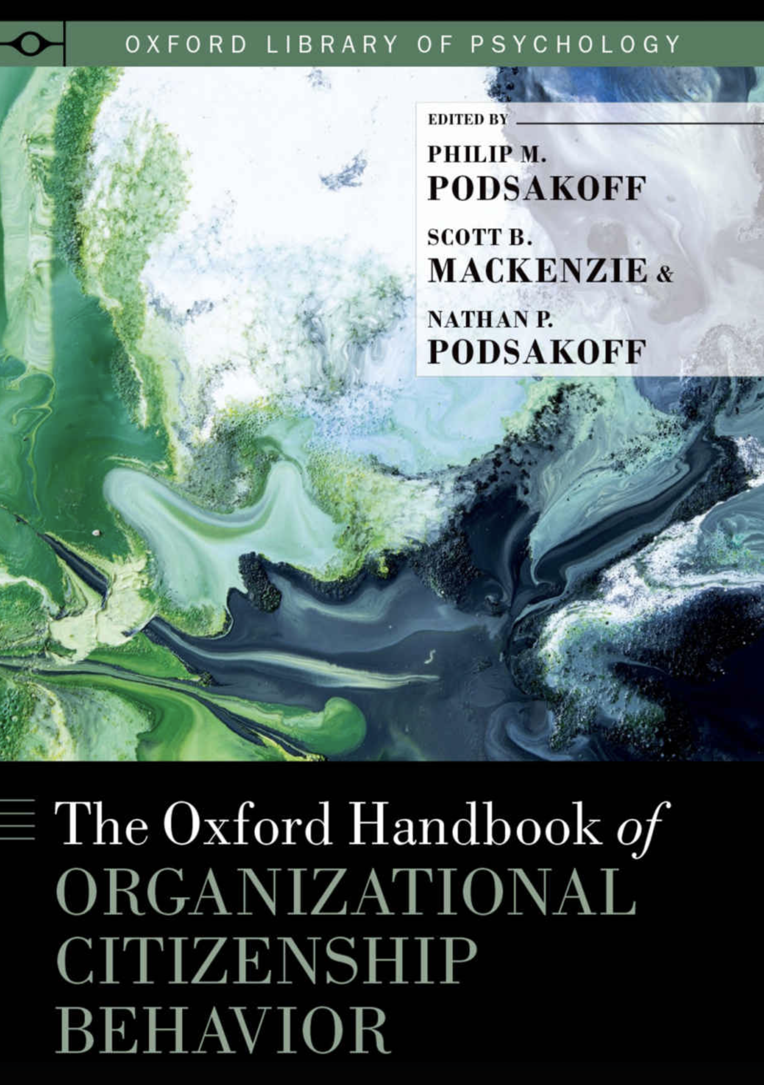
Inspiration
Random
…variation should be considered one of the most important explanatory mechanisms in the management sciences
…events impact organizational behavior
…models provide parsimonious explanations of empirical regularities
How Long Must A Firm Be Great To Rule Out Chance?
– Henderson, Raynor, & Ahmed, 2012

Slide 10
Inspiration
Random
…variation should be considered one of the most important explanatory mechanisms in the management sciences
…events impact organizational behavior
…models provide parsimonious explanations of empirical regularities
How Long Must A Firm Be Great To Rule Out Chance?
– Henderson, Raynor, & Ahmed, 2012
“Most incidents of helping are the direct result of a request for help”
– Ehrhart
“A certain proportion of employee helping is in direct response to the solicitation of help by a potential help-recipient”
- Bamberger

Slide 11
Agenda
OCBs
Pattern (Good Soldiers/Extra Milers)
Predictors
Alternative

Slide 12
OCBs

Slide 13
OCBs
…lubricate the social machinery of organizations, facilitating its effective functioning
- Bolino et al., 2002

Slide 14
OCBs
…lubricate the social machinery of organizations, facilitating its effective functioning
- Bolino et al., 2002
…shape the org, social, and psych context acting as a catalyst for activities and processes
- Borman & Motowidlo, 1997

Slide 15
OCBs
…lubricate the social machinery of organizations, facilitating its effective functioning
- Bolino et al., 2002
…shape the org, social, and psych context acting as a catalyst for activities and processes
- Borman & Motowidlo, 1997
…given same weight as task performance on manager evaluations
- Podsakoff, MacKenzie, & Podsakoff, 2018

Slide 16
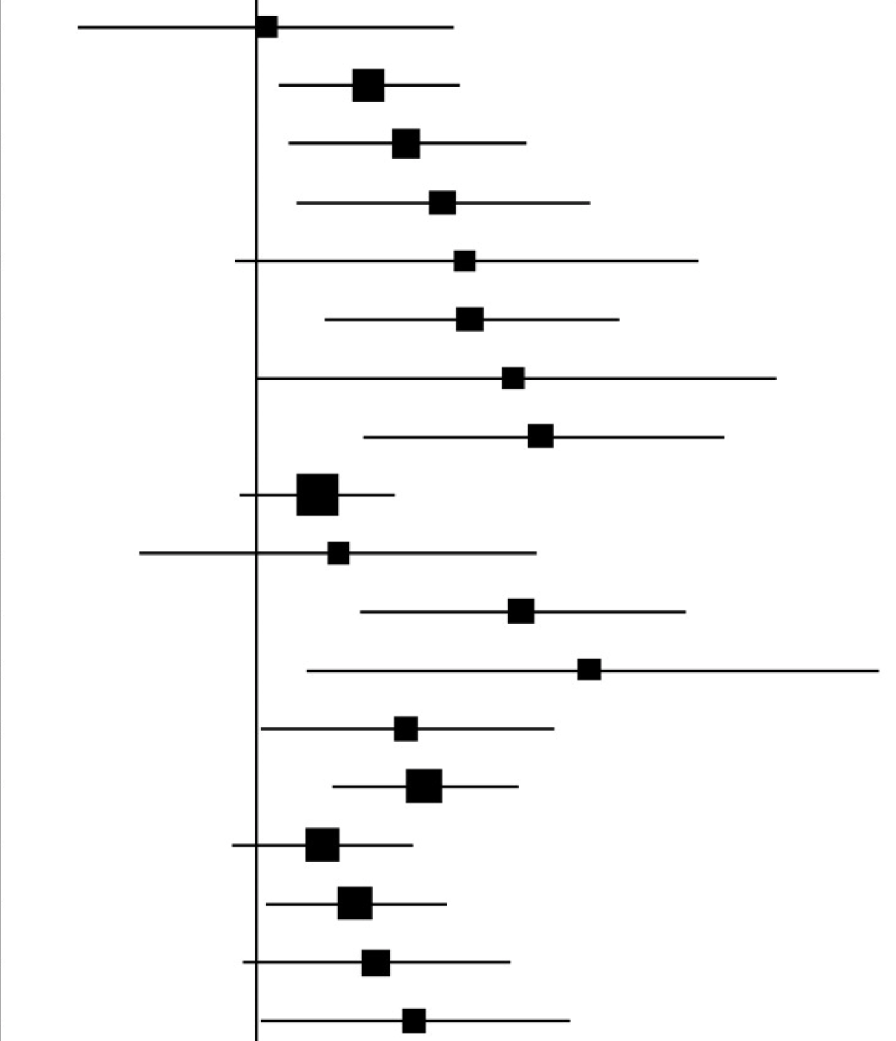
OCBs
…lubricate the social machinery of organizations, facilitating its effective functioning
- Bolino et al., 2002
…shape the org, social, and psych context acting as a catalyst for activities and processes
- Borman & Motowidlo, 1997
…given same weight as task performance on manager evaluations
- Podsakoff, MacKenzie, & Podsakoff, 2018
> 7
> 5

Slide 17
OCBs - dimensions

Slide 18
OCBs - dimensions
Altruism
Generalized Compliance

Slide 19
OCBs - dimensions
Altruism
Generalized Compliance
Altruism
Civic Virtue
Sportsmanship
Courtesy
Conscientiousness

Slide 20
OCBs - dimensions
Altruism
Generalized Compliance
Altruism
Civic Virtue
Sportsmanship
Courtesy
Conscientiousness
OCB-I
OCB-O

Slide 21
OCBs - dimensions
Altruism
Generalized Compliance
Altruism
Civic Virtue
Sportsmanship
Courtesy
Conscientiousness
OCB-I
OCB-O
Affiliative
Challenging

Slide 22
Pattern

Slide 23
Pattern
Extra Milers
- Li, Zhao, Walter, Zhang, & Yu, 2015
Good Soldiers
- Methot, Lepak, Shipp, & Boswell, 2017
- Bolino 2015

Slide 24


Pattern
Extra Milers
- Li, Zhao, Walter, Zhang, & Yu, 2015
Good Soldiers
- Methot, Lepak, Shipp, & Boswell, 2017
- Bolino 2015
OCBs

Slide 25
Pattern
Extra Milers
- Li, Zhao, Walter, Zhang, & Yu, 2015
Good Soldiers
- Methot, Lepak, Shipp, & Boswell, 2017
- Bolino 2015
OCBs

Slide 26
Pattern
Extra Milers
- Li, Zhao, Walter, Zhang, & Yu, 2015
Good Soldiers
- Methot, Lepak, Shipp, & Boswell, 2017
- Bolino 2015
OCBs
Time

Slide 27
Pattern
Extra Milers
- Li, Zhao, Walter, Zhang, & Yu, 2015
Good Soldiers
- Methot, Lepak, Shipp, & Boswell, 2017
- Bolino 2015
OCBs
Time

Slide 28
Pattern
Extra Milers
- Li, Zhao, Walter, Zhang, & Yu, 2015
Good Soldiers
- Methot, Lepak, Shipp, & Boswell, 2017
- Bolino 2015
OCBs
Time

Slide 29
Pattern
Extra Milers
- Li, Zhao, Walter, Zhang, & Yu, 2015
Good Soldiers
- Methot, Lepak, Shipp, & Boswell, 2017
- Bolino 2015
>
OCBs
Time

Slide 30
Predictors
Prosocial Motives | Personality Fairness | Values
Satisfaction
OCBs
Time

Slide 31
Alternative

Slide 32
Alternative
Situation
- Requests
Chance
- Random Walks

Slide 33
Alternative
Situation
- Requests
Chance
- Random Walks
OCBs

Slide 34
Alternative
Situation
- Requests
Chance
- Random Walks
OCBs

Slide 35
Alternative
Situation
- Requests
Chance
- Random Walks
>
OCBs
Time
Notes:
Why is that?

Slide 36
Alternative
Situation
- Requests
Chance
- Random Walks

Slide 37
Alternative
Situation
- Requests
Chance
- Random Walks

Slide 38
Alternative
Situation
- Requests
Chance
- Random Walks
>
Opportunity Stock
Employee_{i}
Opportunity Stock
Employee_{i+1}

Slide 39
Alternative
Situation
- Requests
Chance
- Random Walks
>
>
Opportunity Stock
Employee_{i}
Opportunity Stock
Employee_{i+1}

Slide 40
Alternative
Situation
- Requests
Chance
- Random Walks
>
>
>
Opportunity Stock
Employee_{i}
Opportunity Stock
Employee_{i+1}

Slide 41
Alternative
Study 1
- Requests follow random walks when they accumulate over time
Study 2
- Randomly accumulating requests yield vast differences in opportunity

Slide 42
Alternative
Study 1
- Requests follow random walks when they accumulate over time
Study 2
- Randomly accumulating requests yield vast differences in opportunity
Theory
- Simon/OCB/Stochastics

Slide 43
Alternative
Study 1
- Requests follow random walks when they accumulate over time
Study 2
- Randomly accumulating requests yield vast differences in opportunity
Theory
- Simon/OCB/Stochastics
Approach
- Archival

Slide 44
Alternative
Study 1
- Requests follow random walks when they accumulate over time
Study 2
- Randomly accumulating requests yield vast differences in opportunity
Theory
- Simon/OCB/Stochastics
Theory
- Probability
Approach
- Archival

Slide 45
Alternative
Study 1
- Requests follow random walks when they accumulate over time
Study 2
- Randomly accumulating requests yield vast differences in opportunity
Theory
- Simon/OCB/Stochastics
Theory
- Probability
Approach
- Archival
Approach
- Simulation

